Slide 1
RASD 3.0
Notes:
travlendar’s PURPOSE is to SIMPLIFY user's daily life and HELP them to SCHEDULE their activities.
In order to do that, it must INCORPORATE many functionalities that are currently provided by many separate applications (calendar, maps, travel scheduler…)
inside travlendar, each user owns a calendar and a set of preferences
FORMALLY -> NEXT SLIDE
• Identify the best mobility option;
• Support the user in buying public transport tickets, if necessary;
• Locate the nearest car or bike sharing, if they represent the best
solution;
• Warn the user when a place can’t be reached in the available time.
In general, Travlendar+ should make it easier to organize complex schedules, by finding the best compromises between time optimization and the users’ needs and preferences.

Slide 2
RASD 3.0: goals
- [G1] Users should be able to use the system properly
- [G2] Allow users to schedule an activity - [G3] Allow users to set constraints and preferences - [G4] Simplify procedures and reduce the number of operations that a user has to do to schedule a new activity - [G5] Make sure users are on time at their scheduled appointments or that they’re warned when they can’t be on time
-[R2] Users should be able to log in to Travlendar+ and, together, [R3] Users should be able to register to Travlendar+.
-[R8] Users should be warned when they’re scheduling an activity that is not physically possible due to a lack of time or that overlaps with other activities.
-[R5] Users should be able to schedule new activities.
-[R11] The application should identify the best mobility option. Moreover, this should be done by appointment and by day.
Notes:
FORMALLY speaking, users’ needs are described by the goals on the left, and they're mapped with requirements on the right.
from most trivial to more complex ones
REQUIREMENTS AND ASSUMPTIONS IMPLY GOALS

Slide 3
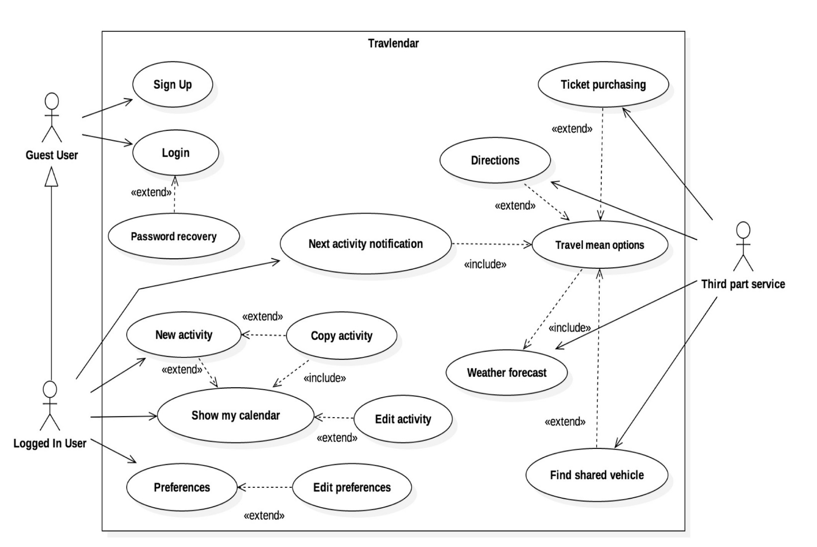
RASD 3.0: use cases
The RASD also contains the description and the analysis (tables) of Travlendar+’s use cases. The diagram on the side summarizes them. Later on we analyze in details the most revelant use cases.
Notes:
to catch interaction user/system design
almost every relevant use case

Slide 4
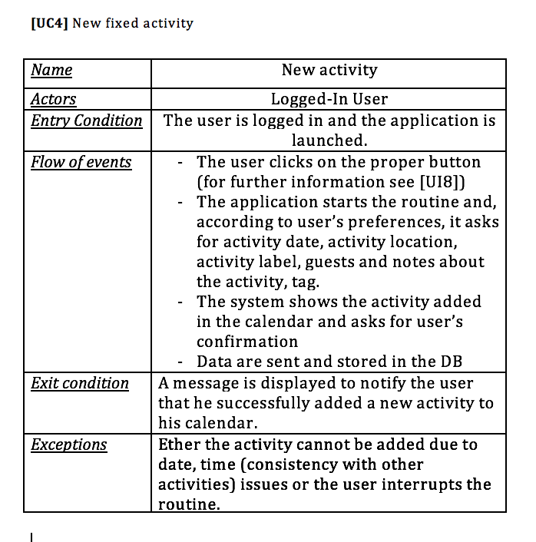
RASD 3.0: use cases
Due to Travlendar+ scope and functionalities, a core use case is for sure the one regarding the insertion of a New Activity
In our Use Case Diagram, the New Activity use case extends the Show My Calendar use case, since it will be possible to start the insertion of a new activity directly from the calendar screen
It’s extended by the Copy Activity use case, since each time it will be possible to add a new activity by copying an existing one
NOTICE: The table regards just ‘fixed’ activities since ‘flexible’ ones (e.g. lunch) differs a little bit in the flow of events. In fact, for sake of simplicity, the system manages differently the two kinds of activities.
Notes:
we identified this as the most important use case, that we thought it was worth to describe in details
- performed by user logged
- used inserts data
- server computes and answers ANYWAY (make users aware)
user is showed the result
Precise flow of events
exceptions

Slide 5
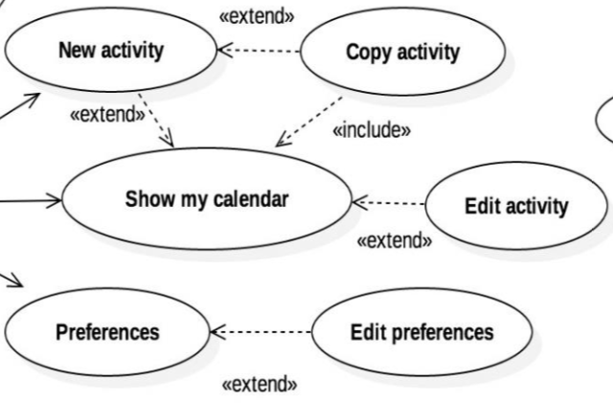
RASD 3.0: use cases
In light of the implementation, another highly relevant use case is the ‘show my calendar’ use case.
In fact, due to how the clients have been designed, the calendar screen emerges as the main screen, from which the user can reach every functionality.
For these reasons this use case gains a core role and the corresponding screens in the clients have been developed as more intuitive as possible.
For more details see also the Implementation section of this presentation
Notes:
Another important use case emerged by the implementation
Include/extend
More intuitive as possible
reach every functionality

Slide 6
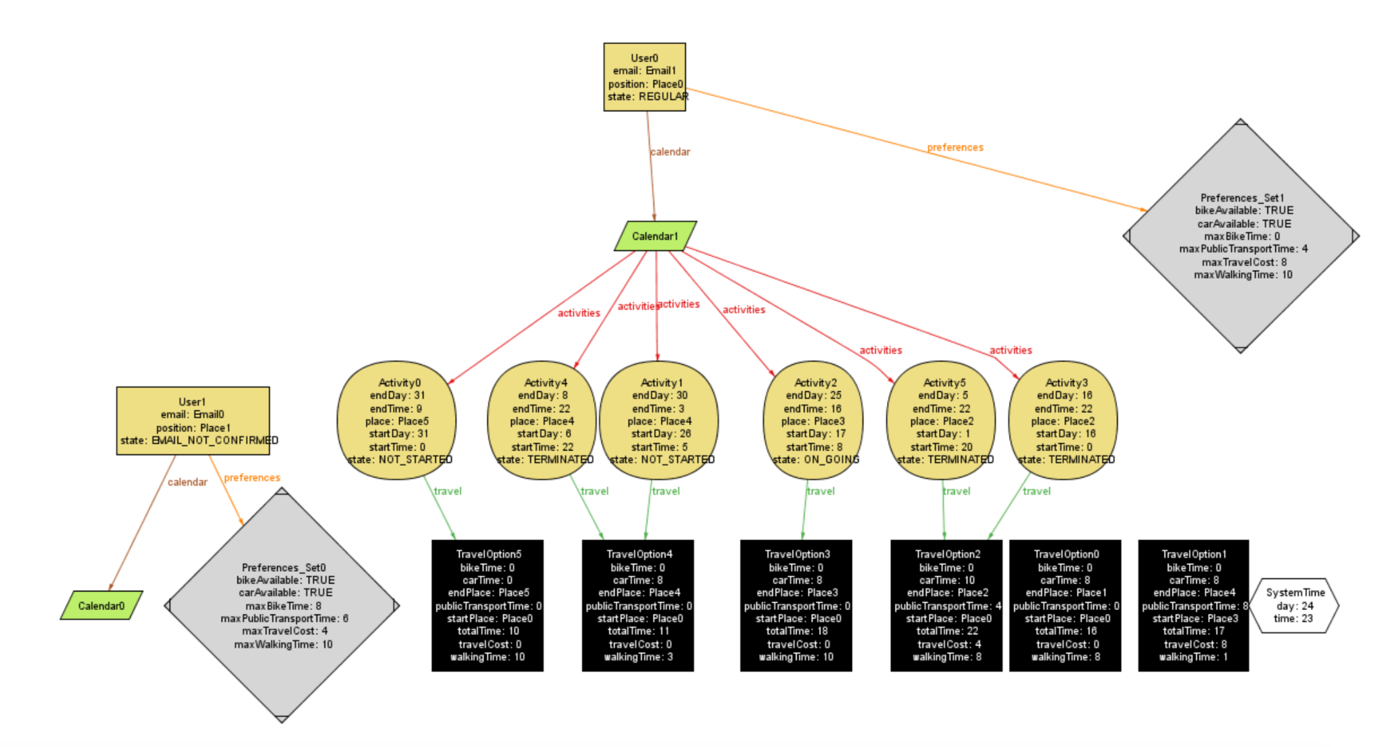
RASD 3.0: alloy
We used Alloy to show that the system we designed, that is subject to the aforementioned constraints, remains consistent.
In fact, our Alloy specification (see RASD) respected all the constraints and was still able to generate some possible worlds.
Notes:
Since the system is really complex (involves MANY ENTITIES users, calendars, events, preferences…) it has been necessary to give a proof of consistency
possible world proves our system's consistency
Now my colleague Emilio will introduce you the DD

Slide 7
DD 1.0
Notes:
showed models here

Slide 8
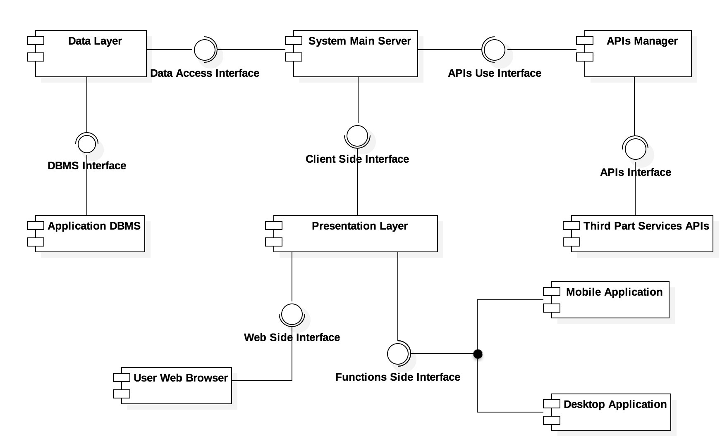
DD 1.0: components diagrams
The component diagram on the side represents an overview of all components and interfaces composing our system.
The core component of the entire system is for sure the System Main Server, “brain” of the server.
Notes:
system main server most important
it makes use of external services (APIs)
data layer used to access data -> DBMS
clients are behind presentation layer

Slide 9
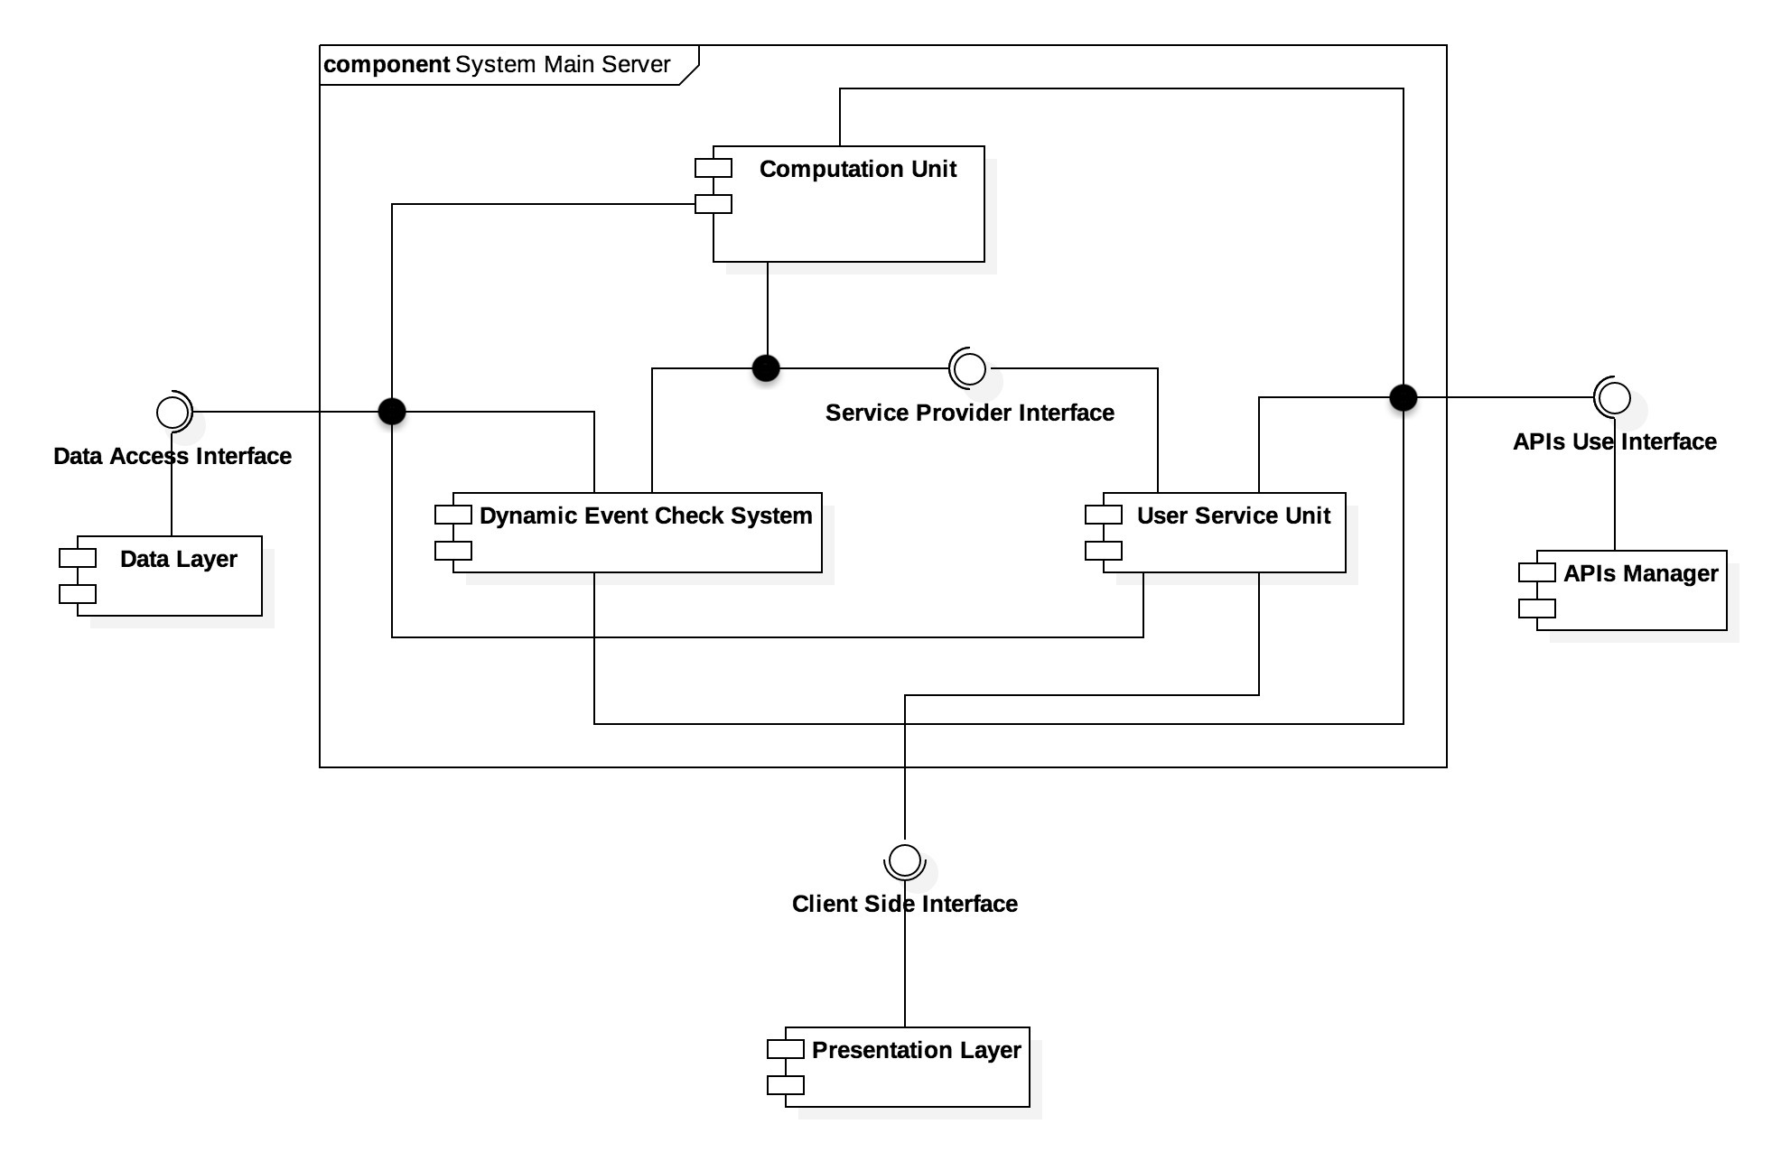
DD 1.0: components diagrams
Here we describe the System Main Server in details.
Some features to be noticed:
It contains the so-called Computational Unit, house of all the computation in our system, connected to all the other internal components by means of the Service Provider Interface
It’s connected to every secondary external components (by means of the Data Access Interface and the APIs Use Interface)
Notes:
details of system main server
it handles most of the computations, including best mobility option and consistency of calendars
connected to APIs Man and Data Layer
DECS is completely SEPARATED. In fact, the notification system can in theory run on a different server if necessary to improve performances

Slide 10
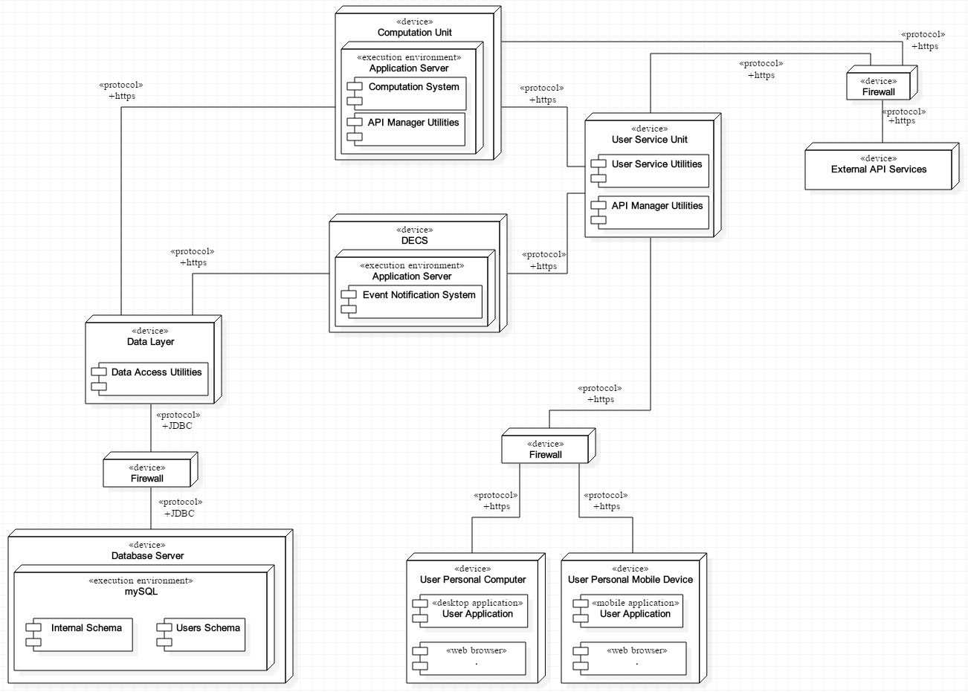
DD 1.0: deployment diagram
Here we show the correspondent deployment diagram.
As you can see, some components have been merged into other physical entities, while others have been implemented through different physical devices.
Notes:
some components are merged into one here
some components have been split here

Slide 11
DD 1.0: architectural styles
Different architectural styles and design patterns have been taken into account during the design phase.
Following the chosen and implemented ones in our system.

Slide 12
DD 1.0: architectural styles
First of all, the Three Tiers(Layers) Architecture. We divided our system in the different macro-components:
-the Presentation Tier, containing both the Presentation Layer on the server and the remote Clients;
-the Application Tier, containing all components not related with data (System Main Server and API Manager);
-the Data Tier represented by the Data Layer together with the DBMS
Notes:
P tier -> clients
D tier -> DBMS & data layer
C ties -> server + DECS

Slide 13
DD 1.0: architectural styles
Also the core OO concept of encapsulation have been widely used during the implementation.
Last but not least, the design pattern MVC (Model-View-Controller) have been taken into account designing the interaction client-server.
Notes:
MVC improve extensibility, it makes it easier to develop different clients without mofying the server

Slide 14
ITD 1.0
Notes:
showed models here

Slide 15
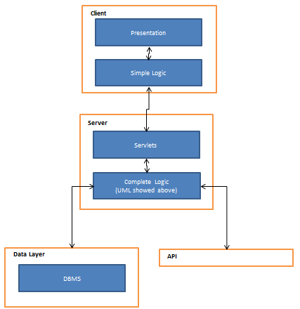
ITD 1.0: Servlets
The server is developed using Java Enterprise Edition and organized in servlets. All the servlets accept both GET and POST http requests.
This structure goes in favour of extesibility.
Notes:
showed models here

Slide 16
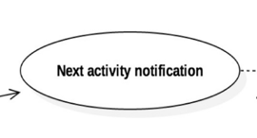
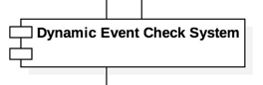
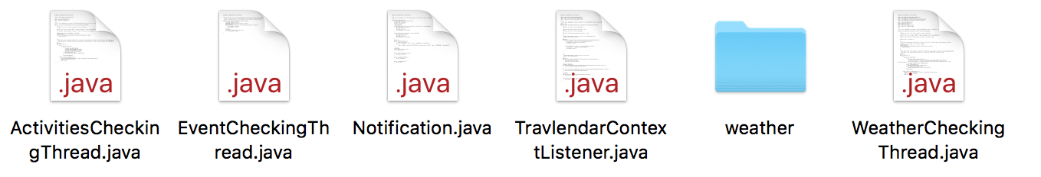
ITD 1.0: notification system
Since Travlendar’s main purpose is help users to schedule their events to never be late and never forget them, notifications are an important feature for such an application.
In our system notifications concern unexpected events or conditions, such as public strikes (not implemented due to lack of sources), weather forecast (successfully implemented by means of Yahoo Weather APIs), routes congestion (included in directions by Google Maps APIs), or simple push notifications about imminent scheduled events.

Slide 17
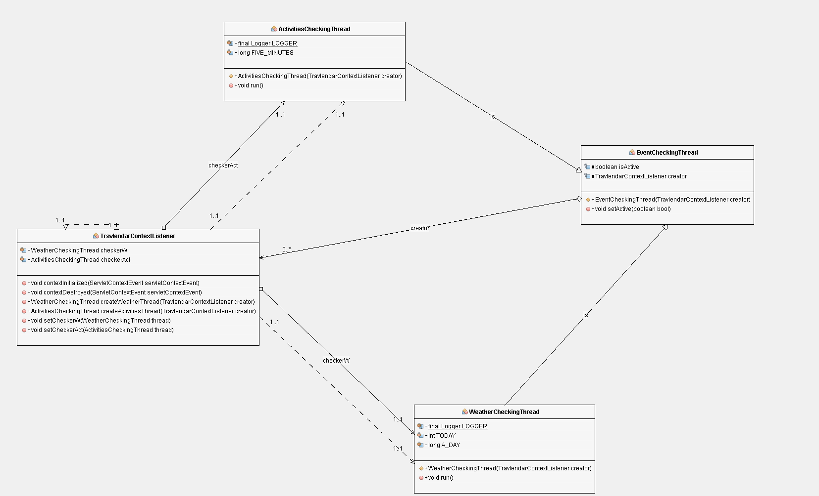
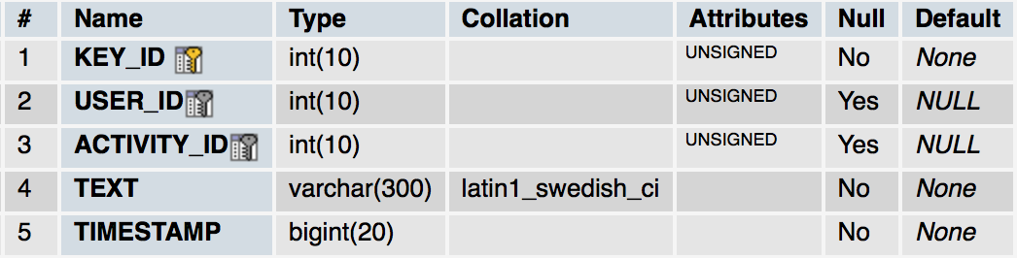
ITD 1.0: notification system
On the server, the notification system has been implemented as background tasks (threads) that wake up periodically with a suitable frequency.
These tasks saves tuples in the DB with info regarding the type of notification and the user and the activity concerned, a timestamp.
Due to the HTTP paradigm, our server is not able to notify directly the user, but he gets his notifications each time he create a new connection through the client app.
Notice that the notification retrieving system is currently implemented only in the desktop client, but the the implementation on the server is fully compatible with a future implementation on other clients.

Slide 18
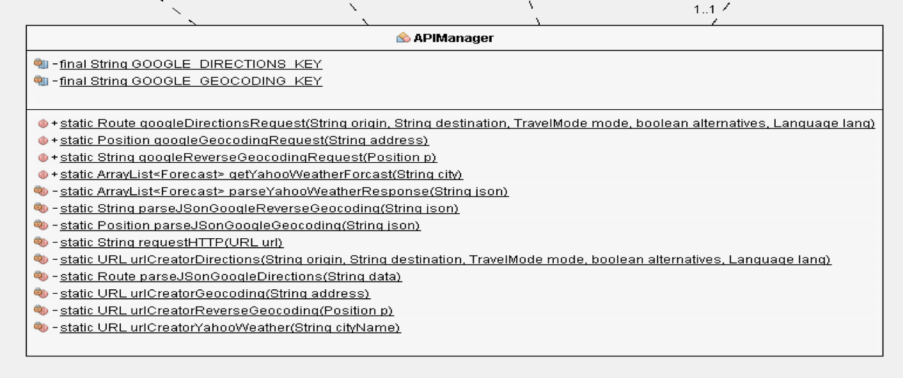
ITD 1.0: APIs
The system makes use of many services that are offered by external system.
To make it easier to have those services available in our system in a simple way we managed to encapsulate the requests in the APIManager Class.
We used:
Google Directions APIs
Google Geocoding and Reverse Geocoding APIs
Yahoo! Weather APIs

Slide 19
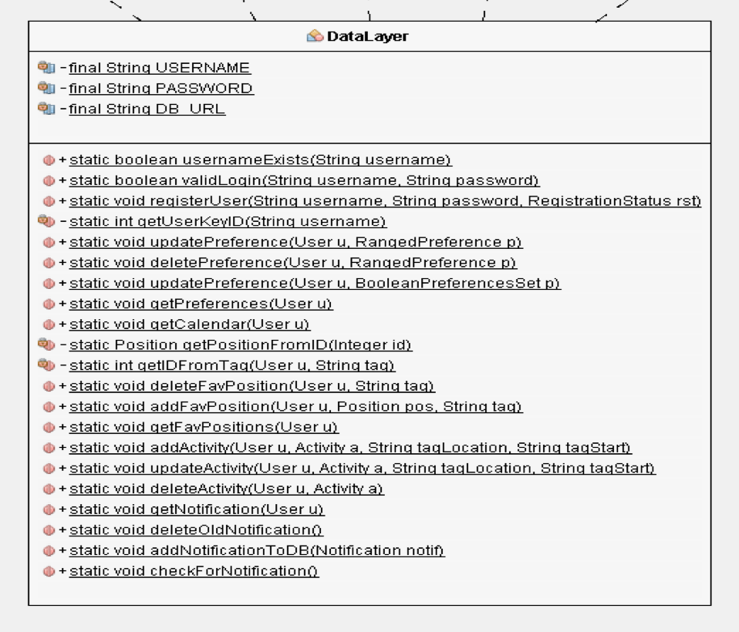
ITD 1.0: Data Layer
As for the APIManager, the Data Layer encapsulates all the requests to the DBMS so that the rest of the system can access data in a easy way.
This “adapter” strategy goes in favour of extensibility as well.

Slide 20
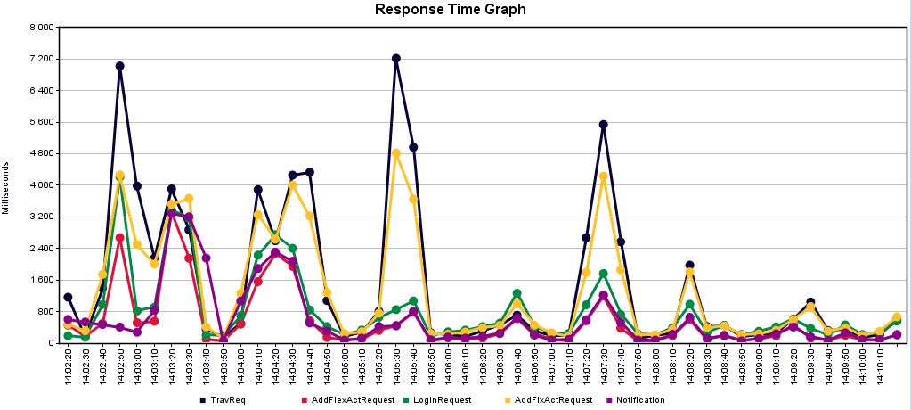
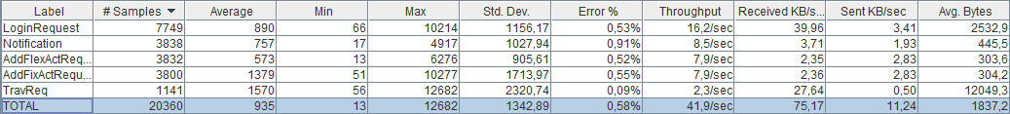
ITD 1.0: Performance testing
Among all the performances tests we performed, this is the most relevant.
We sent to the server many of the requests that are, computationally speaking, the most expensive ones.
Notes:
showed models here

